Slide 1
CSE214 – Analysis of Algorithms PhD Furkan Gözükara, Toros University https://github.com/FurkanGozukara/Analysis-of-Algorithms-2019
Lecture 10
Graphs
Based George Bebis Lecture Notes - Reno Logo University of Nevada

Slide 2
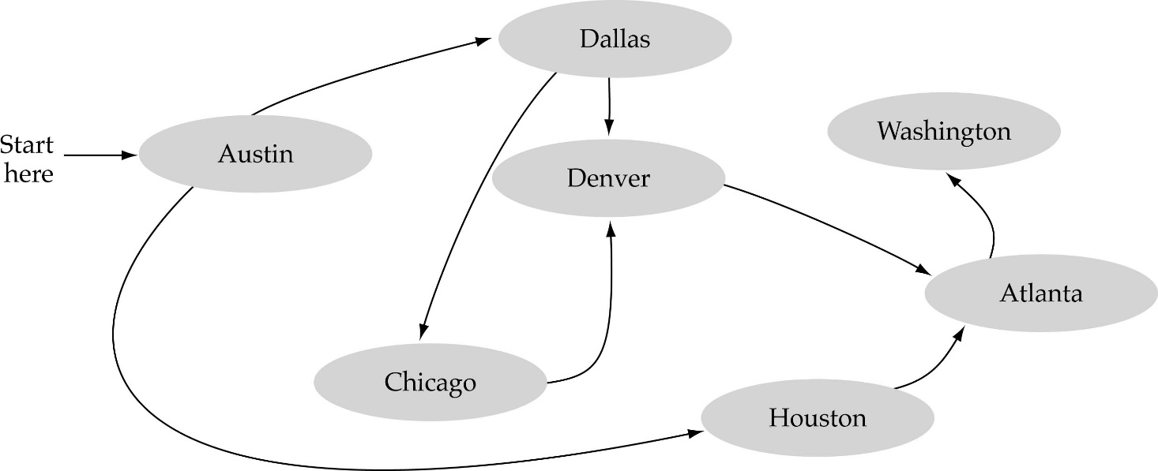
What is a graph?
A data structure that consists of a set of nodes (vertices) and a set of edges that relate the nodes to each other
The set of edges describes relationships among the vertices

Slide 3
Formal definition of graphs
A graph G is defined as follows:
G=(V,E)
V(G): a finite, nonempty set of vertices
E(G): a set of edges (pairs of vertices)

Slide 4
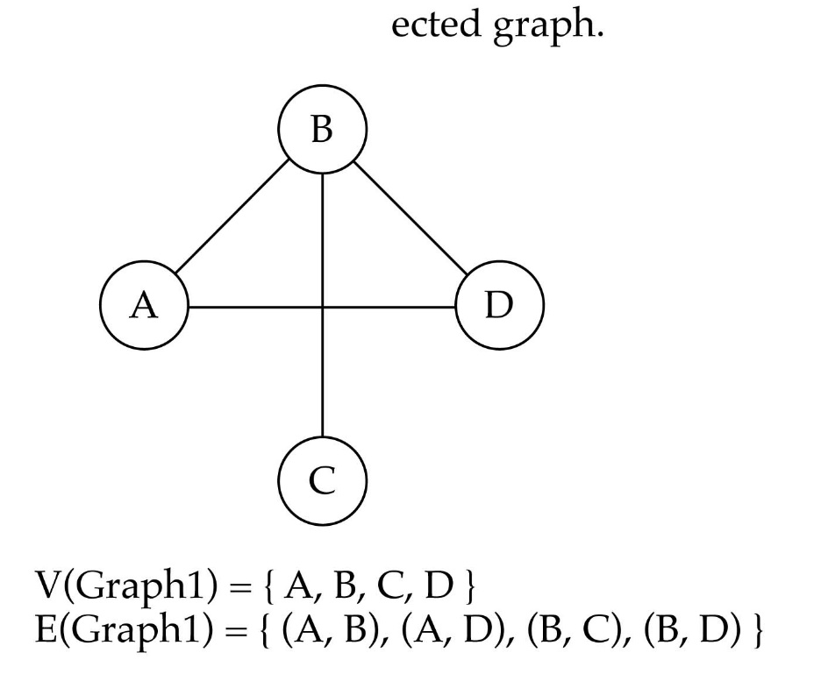

Directed vs. undirected graphs
When the edges in a graph have no direction, the graph is called undirected

Slide 5
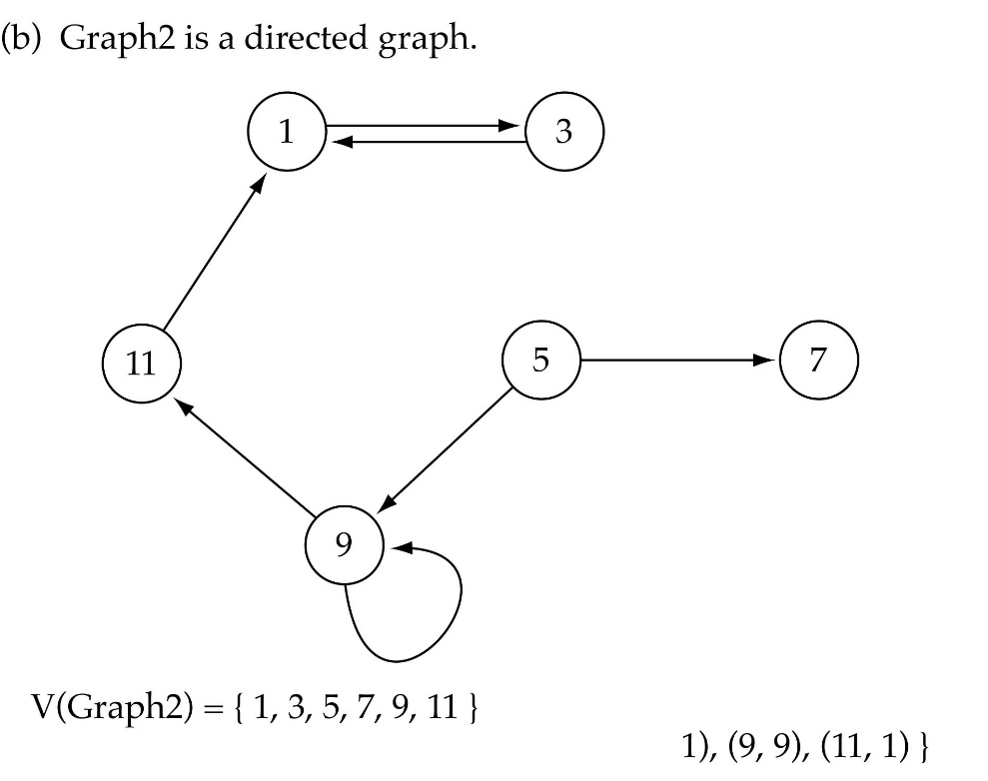

Directed vs. undirected graphs (cont.)
When the edges in a graph have a direction, the graph is called directed (or digraph)
Warning: if the graph is directed, the order of the vertices in each edge is important !!
E(Graph2) = {(1,3) (3,1) (5,9) (9,11) (5,7)

Slide 6
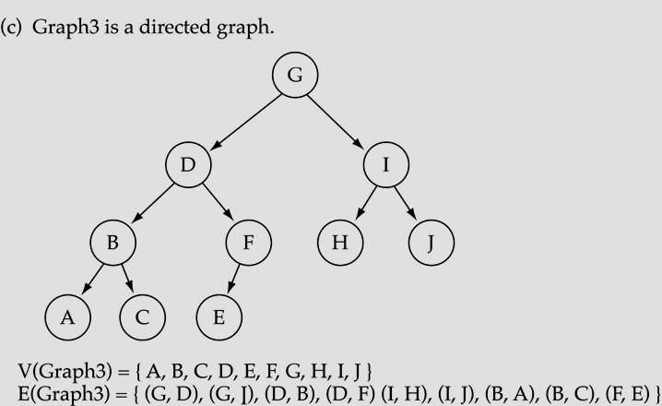
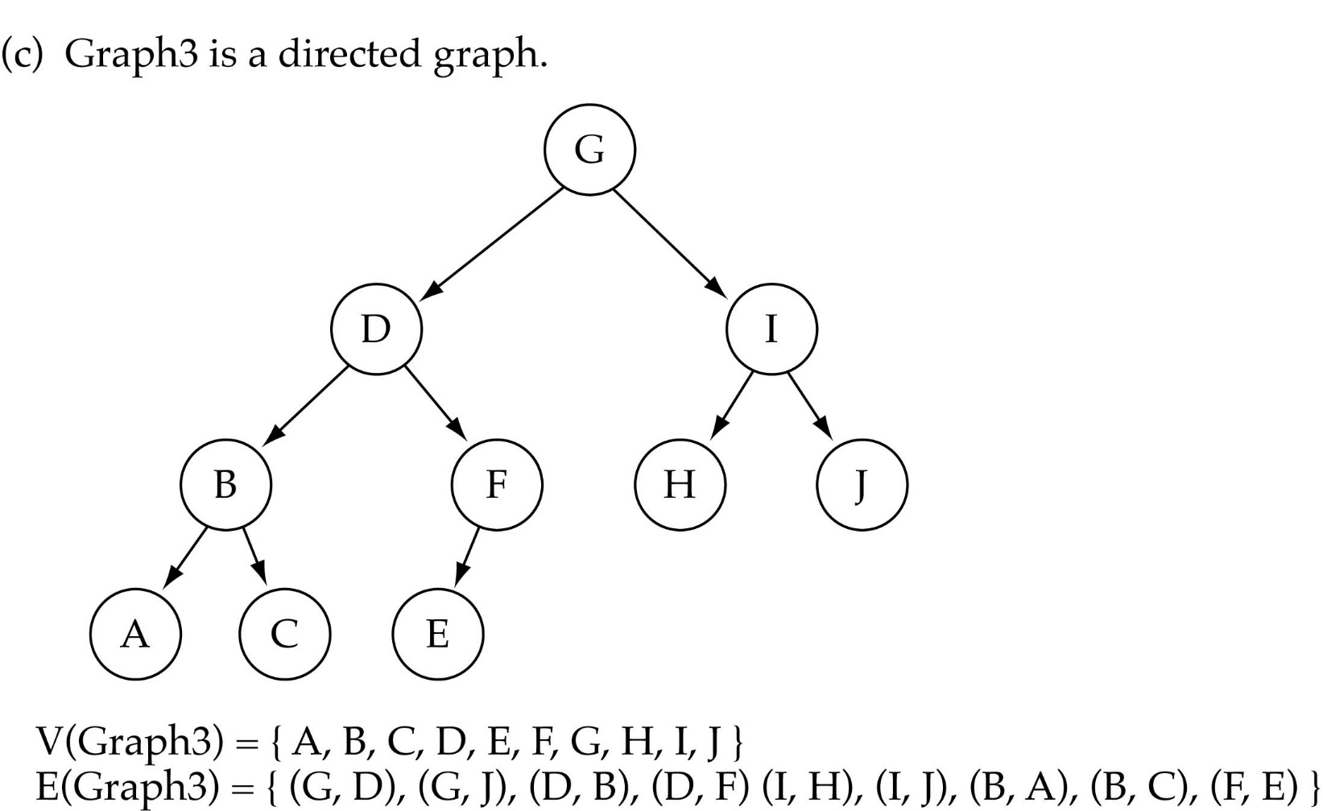
Trees vs graphs
Trees are special cases of graphs!!

Slide 7
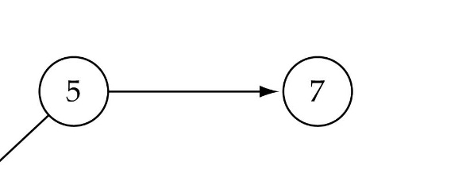
Graph terminology
Adjacent nodes: two nodes are adjacent if they are connected by an edge
Path: a sequence of vertices that connect two nodes in a graph
Complete graph: a graph in which every vertex is directly connected to every other vertex
5 is adjacent to 7
7 is adjacent from 5

Slide 8
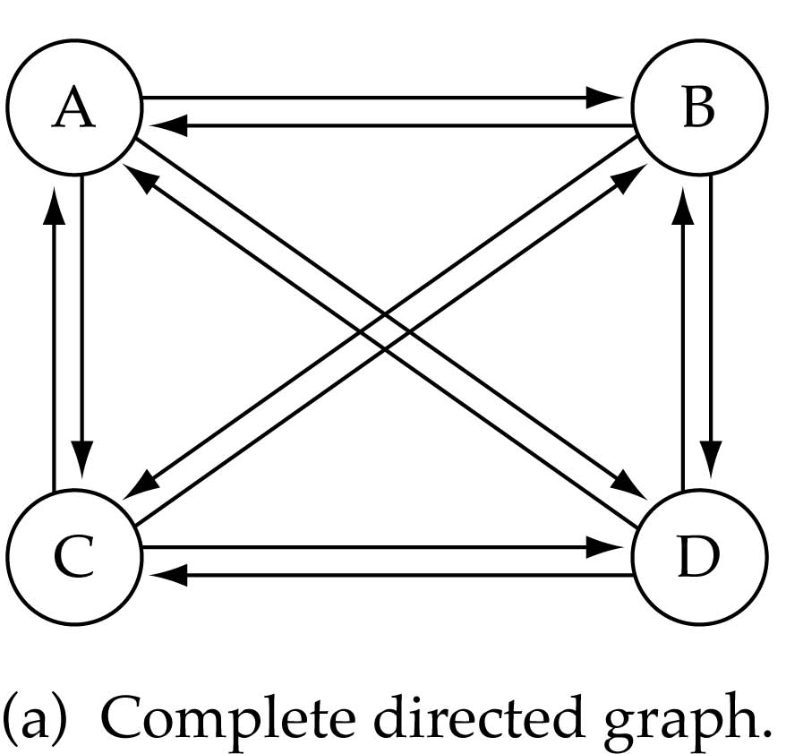
Graph terminology (cont.)
What is the number of edges in a complete directed graph with N vertices?
N * (N-1)

Slide 9
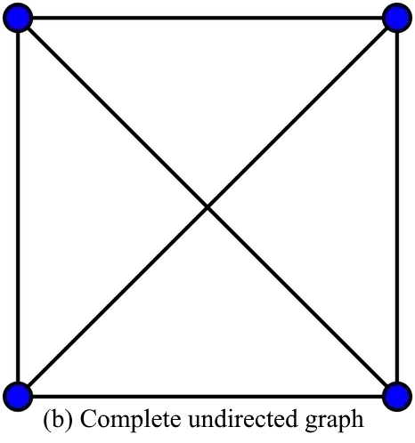
Graph terminology (cont.)
What is the number of edges in a complete undirected graph with N vertices?
N * (N-1) / 2

Slide 10
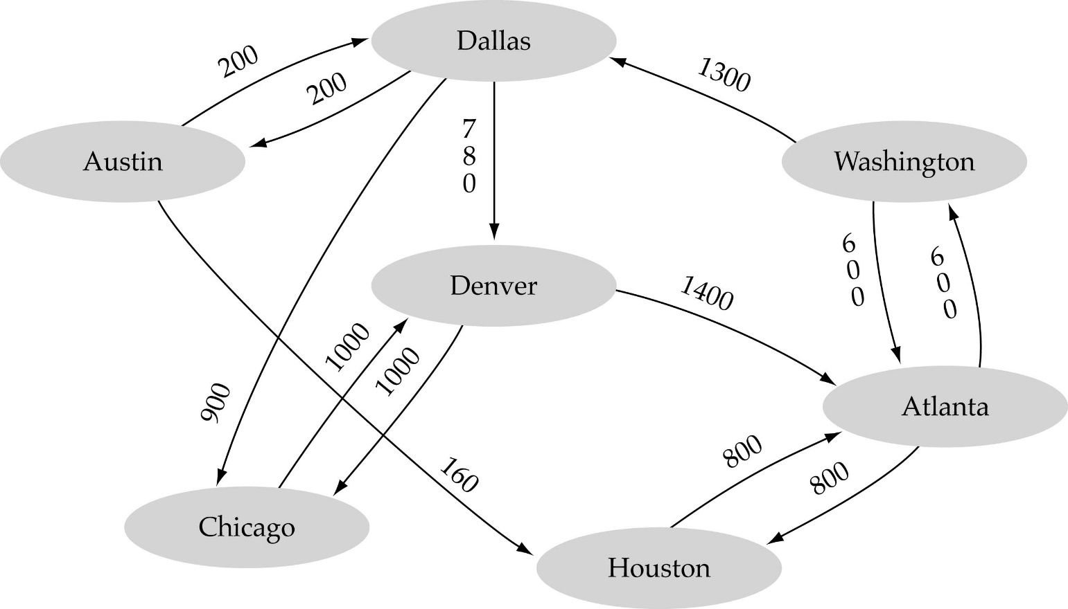
Graph terminology (cont.)
Weighted graph: a graph in which each edge carries a value

Slide 11

Graph implementation
Array-based implementation
A 1D array is used to represent the vertices
A 2D array (adjacency matrix) is used to represent the edges

Slide 12
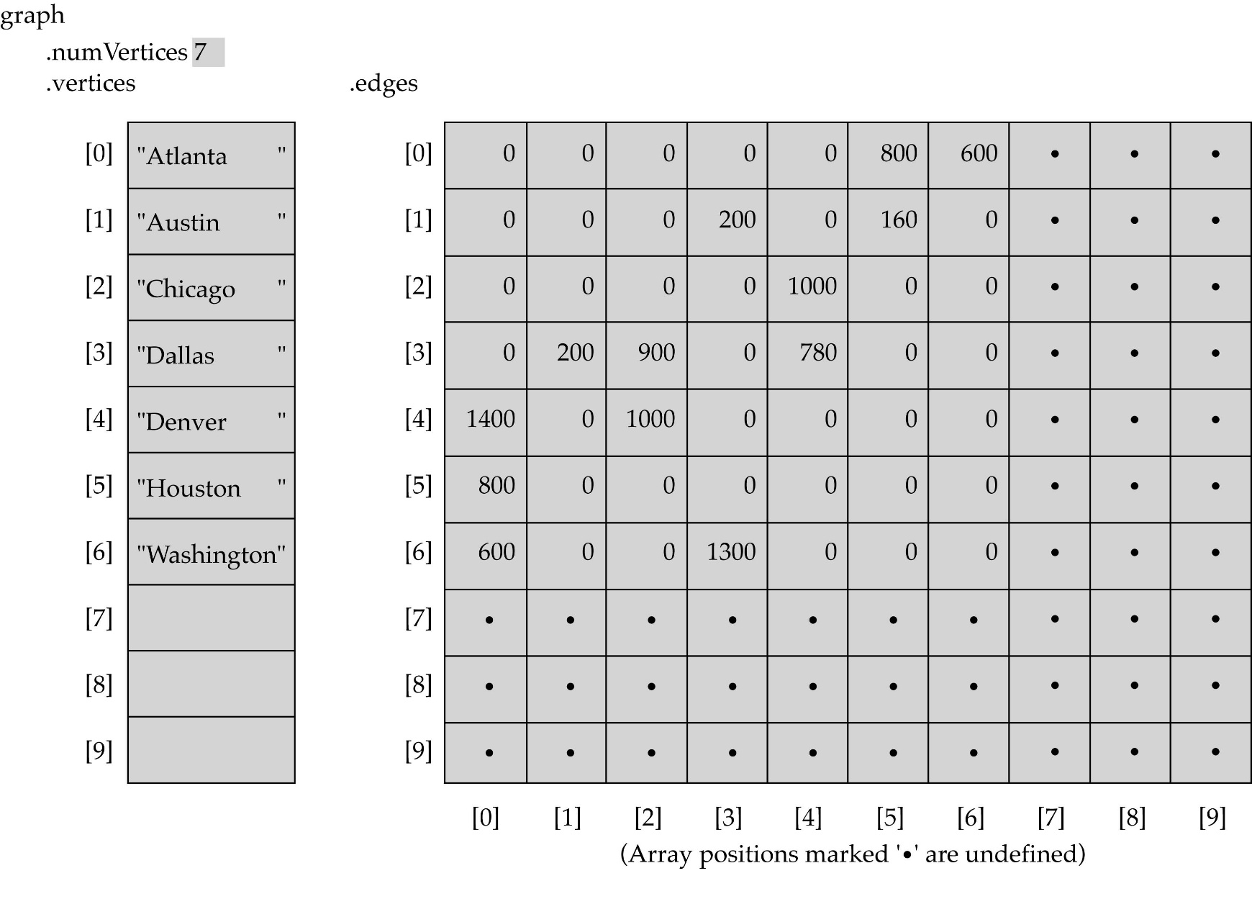
Array-based implementation

Slide 13

Graph implementation (cont.)
Linked-list implementation
A 1D array is used to represent the vertices
A list is used for each vertex v which contains the vertices which are adjacent from v (adjacency list)

Slide 14
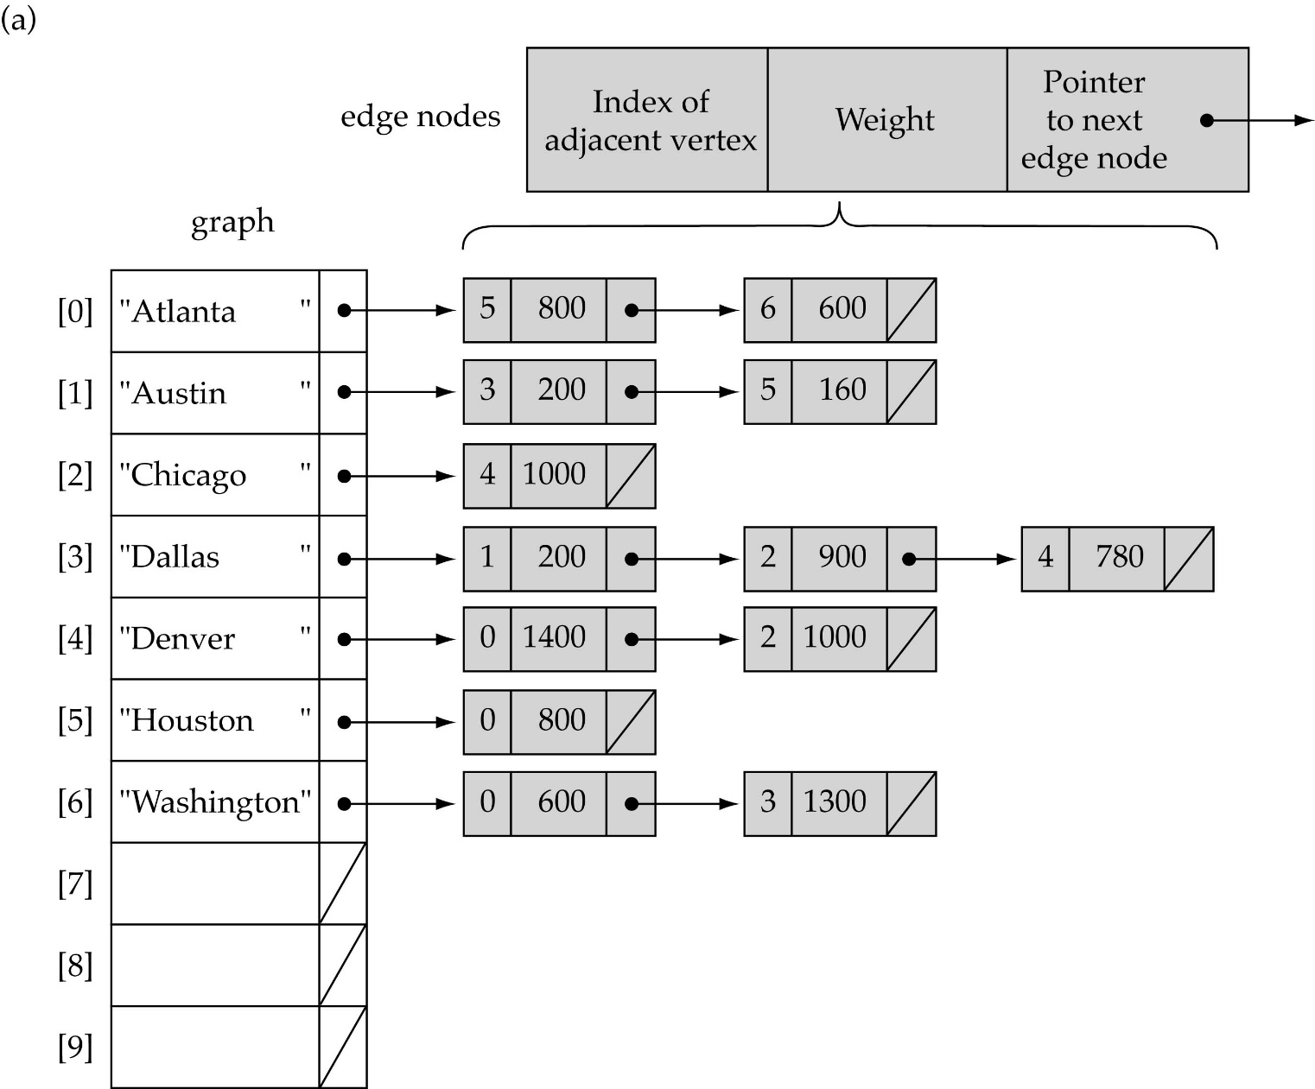
Linked-list implementation

Slide 15
Adjacency matrix vs. adjacency list representation
Adjacency matrix
Good for dense graphs --|E|~O(|V|²)
Memory requirements: O(|V| + |E| ) = O(|V|² )
Connectivity between two vertices can be tested quickly
Adjacency list
Good for sparse graphs -- |E|~O(|V|)
Memory requirements: O(|V| + |E|)=O(|V|)
Vertices adjacent to another vertex can be found quickly

Slide 16
Graph searching
Problem: find a path between two nodes of the graph (e.g., Austin and Washington)
Methods: Depth-First-Search (DFS) or Breadth-First-Search (BFS)

Slide 17
Depth-First-Search (DFS)
What is the idea behind DFS?
Travel as far as you can down a path
Back up as little as possible when you reach a "dead end" (i.e., next vertex has been "marked" or there is no next vertex)
DFS can be implemented efficiently using a stack

Slide 18
What is a Stack?
A stack is a list with the restriction that insertions and deletions can be performed in only one position, namely, the end of the list, called the top.
The operations: push (insert) and pop (delete)
pop
push(o)
Top
3
2
7
6

Slide 19
Breadth-First-Searching (BFS)
What is the idea behind BFS?
Look at all possible paths at the same depth before you go at a deeper level
Back up as far as possible when you reach a "dead end" (i.e., next vertex has been "marked" or there is no next vertex)

Slide 20
Depth-First
Graph
Traversal Algorithm
Alyce Brady
Kalamazoo College

Slide 21
Search vs Traversal
Tree Search: Look for a given node
stop when node found, even if not all nodes were visited
Tree Traversal: Always visit all nodes

Slide 22
Depth-first Search
Similar to Depth-first Traversal of a Binary Tree
Choose a starting vertex
Do a depth-first search on each adjacent vertex
Notes:
Vertex vertices in tekili

Slide 23
Pseudo-Code for Depth-First Search
depth-first-search
mark vertex as visited
for each adjacent vertex
if unvisited
do a depth-first search on adjacent vertex

Slide 24
Depth-First Search
A
B
C
D
E
F
G

Slide 25
Depth-First Search
v
A
B
C
D
E
F
G
A

Slide 26
Depth-First Search
v
A
B
C
D
E
F
G
A

Slide 27
Depth-First Search
v
A
v
B
C
D
E
F
G
A B

Slide 28
Depth-First Search
v
A
v
B
C
D
E
F
G
A B

Slide 29
Depth-First Search
v
A
v
B
C
D
E
F
G
A B

Slide 30
Depth-First Search
v
A
v
B
C
v
D
E
F
G
A B D

Slide 31
Depth-First Search
v
A
v
B
C
v
D
E
F
G
A B D

Slide 32
Depth-First Search
v
A
v
B
C
v
D
E
F
G
A B D

Slide 33
Depth-First Search
v
A
v
B
C
v
D
E
v
F
G
A B D E

Slide 34
Depth-First Search
v
A
v
B
C
v
D
E
v
F
G
A B D E

Slide 35
Depth-First Search
v
A
v
B
C
v
D
E
v
F
G
A B D E

Slide 36
Depth-First Search
v
A
v
B
C
v
D
E
F
G
A B D E

Slide 37
Depth-First Search
v
A
v
B
C
v
D
E
v
F
G
A B D E

Slide 38
Depth-First Search
v
A
v
B
C
v
D
E
v
F
G
A B D E

Slide 39
Depth-First Search
v
A
v
B
C
v
D
E
v
F
G
A B D E

Slide 40
Depth-First Search
v
A
v
B
C
v
D
E
v
F
G
v
A B D E F

Slide 41
Depth-First Search
v
A
v
B
C
v
D
E
v
F
G
v
A B D E F

Slide 42
Depth-First Search
v
A
v
B
C
v
D
E
v
F
G
v
A B D E F

Slide 43
Depth-First Search
v
A
v
v
B
C
v
D
E
v
F
G
v
A B D E F C

Slide 44
Depth-First Search
v
A
v
v
B
C
v
D
E
v
F
G
v
A B D E F C

Slide 45
Depth-First Search
v
A
v
v
B
C
v
D
E
v
F
G
v
A B D E F C

Slide 46
Depth-First Search
v
A
v
v
B
C
v
D
E
v
F
G
v
A B D E F C

Slide 47
Depth-First Search
v
A
v
v
B
C
v
v
v
D
E
F
G
v
A B D E F C G

Slide 48
Depth-First Search
v
A
v
v
B
C
v
v
v
D
E
F
G
v
A B D E F C G

Slide 49
Depth-First Search
v
A
v
v
B
C
v
v
v
D
E
F
G
v
A B D E F C G

Slide 50
Depth-First Search
v
A
v
v
B
C
v
v
v
D
E
F
G
v
A B D E F C G

Slide 51
Depth-First Search
v
A
v
v
B
C
v
v
v
D
E
F
G
v
A B D E F C G

Slide 52
Depth-First Search
v
A
v
v
B
C
v
v
v
D
E
F
G
v
A B D E F C G

Slide 53
Depth-First Search
v
A
v
v
B
C
v
v
v
D
E
F
G
v
A B D E F C G

Slide 54
Depth-First Search
v
A
v
v
B
C
v
v
v
D
E
F
G
v
A B D E F C G

Slide 55
Depth-First Search
A
B
C
D
E
F
G
A B D E F C G

Slide 56
Time and Space Complexity for Depth-First Search
Time Complexity
Adjacency Lists
Each node is marked visited once
Each node is checked for each incoming edge
O (v + e)
Adjacency Matrix
Have to check all entries in matrix: O(n²)
Notes:
Adjancency bitişiklik

Slide 57
Time and Space Complexity for Depth-First Search
Space Complexity
Stack to handle nodes as they are explored
Worst case: all nodes put on stack (if graph is linear)
O(n)

Slide 58
Breadth-First
Graph
Traversal Algorithm
Alyce Brady

Slide 59
Breadth-first Search
Similar to Breadth-first Traversal of a Binary Tree
Choose a starting vertex
Search all adjacent vertices
Return to each adjacent vertex in turn and visit all of its adjacent vertices

Slide 60
Pseudo-Code for Breadth-First Search
breadth-first-search
mark starting vertex as visited; put on queue
while the queue is not empty
dequeue the next node
for all unvisited vertices adjacent to this one
mark vertex as visited
add vertex to queue

Slide 61
Breadth-First Search
Queue:
A
B
C
Current:
D
E
F
G

Slide 62
Breadth-First Search
Queue:
v
A
A
B
C
Current:
D
E
F
G

Slide 63
Breadth-First Search
Queue:
v
A
A
B
C
Current:
D
E
F
G
A

Slide 64
Breadth-First Search
Queue:
v
A
B
C
Current:
D
E
F
G
A
A

Slide 65
Breadth-First Search
Queue:
v
A
B
v
B
C
Current:
D
E
F
G
A
A

Slide 66
Breadth-First Search
Queue:
v
A
C
B
v
v
B
C
Current:
D
E
F
G
A
A

Slide 67
Breadth-First Search
Queue:
v
A
C
B
v
v
B
C
Current:
D
E
F
G
B
A

Slide 68
Breadth-First Search
Queue:
v
A
C
v
v
B
C
Current:
D
E
F
G
B
A B

Slide 69
Breadth-First Search
Queue:
v
A
C
v
v
B
C
Current:
D
E
F
G
B
A B

Slide 70
Breadth-First Search
Queue:
v
A
D
C
v
v
B
C
v
Current:
D
E
F
G
B
A B

Slide 71
Breadth-First Search
Queue:
v
A
E
D
C
v
B
C
v
v
Current:
D
E
F
G
B
v
A B

Slide 72
Breadth-First Search
Queue:
v
A
F
E
D
C
v
v
B
C
v
D
E
F
G
Current:
v
v
B
A B

Slide 73
Breadth-First Search
Queue:
v
A
F
E
D
C
v
v
B
C
v
D
E
F
G
Current:
v
v
C
A B

Slide 74
Breadth-First Search
Queue:
v
A
F
E
D
v
v
B
C
v
D
E
F
G
Current:
v
v
C
A B C

Slide 75
Breadth-First Search
Queue:
v
A
F
E
D
v
v
B
C
v
D
E
F
G
Current:
v
v
C
A B C

Slide 76
Breadth-First Search
Queue:
v
A
F
E
D
v
v
B
C
v
D
E
F
G
Current:
v
v
C
A B C

Slide 77
Breadth-First Search
Queue:
v
A
G
F
E
D
v
v
B
C
v
D
E
F
v
G
Current:
v
v
C
A B C

Slide 78
Breadth-First Search
Queue:
v
A
G
F
E
D
v
v
B
C
v
D
E
F
v
G
Current:
v
v
D
A B C

Slide 79
Breadth-First Search
Queue:
v
A
G
F
E
v
v
B
C
v
D
E
F
v
G
Current:
v
v
D
A B C D

Slide 80
Breadth-First Search
Queue:
v
A
G
F
E
v
v
B
C
v
D
E
F
v
G
Current:
v
v
D
A B C D

Slide 81
Breadth-First Search
Queue:
v
A
G
F
E
v
v
B
C
v
D
E
F
v
G
Current:
v
v
D
A B C D

Slide 82
Breadth-First Search
Queue:
v
A
G
F
E
v
v
B
C
v
D
E
F
v
G
Current:
v
v
E
A B C D

Slide 83
Breadth-First Search
Queue:
v
A
G
F
v
v
B
C
v
D
E
F
v
G
Current:
v
v
E
A B C D E

Slide 84
Breadth-First Search
Queue:
v
A
G
F
v
v
B
C
v
D
E
F
v
G
Current:
v
v
E
A B C D E

Slide 85
Breadth-First Search
Queue:
v
A
G
F
v
v
B
C
v
D
E
F
v
G
Current:
v
v
E
A B C D E

Slide 86
Breadth-First Search
Queue:
v
A
G
F
v
v
B
C
v
D
E
F
v
G
Current:
v
v
F
A B C D E

Slide 87
Breadth-First Search
Queue:
v
A
G
v
v
B
C
v
D
E
F
v
G
Current:
v
v
F
A B C D E F

Slide 88
Breadth-First Search
Queue:
v
A
G
v
v
B
C
v
D
E
F
v
G
Current:
v
v
F
A B C D E F

Slide 89
Breadth-First Search
Queue:
v
A
G
v
v
B
C
v
D
E
F
v
G
Current:
v
v
F
A B C D E F

Slide 90
Breadth-First Search
Queue:
v
A
G
v
v
B
C
v
D
E
F
v
G
Current:
v
v
G
A B C D E F

Slide 91
Breadth-First Search
Queue:
v
A
v
v
B
C
v
D
E
F
v
G
Current:
v
v
G
A B C D E F G

Slide 92
Breadth-First Search
Queue:
v
A
v
v
B
C
v
D
E
F
v
G
Current:
v
v
G
A B C D E F G

Slide 93
Breadth-First Search
A
B
C
D
E
F
G
A B C D E F G

Slide 94
Time and Space Complexity for Breadth-First Search
Time Complexity
Adjacency Lists
Each node is added to queue once
Each node is checked for each incoming edge
O (v + e)
Adjacency Matrix
Have to check all entries in matrix: O(n²)

Slide 95
Time and Space Complexity for Breadth-First Search
Space Complexity
Queue to handle unexplored nodes
Worst case: all nodes put on queue (if all are adjacent to first node)
O(n)

Slide 97
Single-source shortest-path problem
There are multiple paths from a source vertex to a destination vertex
Shortest path: the path whose total weight (i.e., sum of edge weights) is minimum
Examples:
Austin->Houston->Atlanta->Washington: 1560 miles
Austin->Dallas->Denver->Atlanta->Washington: 2980 miles

Slide 98
Single-source shortest-path problem (cont.)
Common algorithms: Dijkstra's algorithm, Bellman-Ford algorithm
BFS can be used to solve the shortest graph problem when the graph is weightless or all the weights are the same
(mark vertices before Enqueue)

